Slide 1
Homework Assignment #1:
I/O Performance under Sequential and Random R/W Workloads

Slide 2
Outline
File Input / Output
Application Programming Interface
  POSIX File I/O
  Other APIs
Homework Assignment #1
Reference

Slide 3
File Input / Output
Process A
Read Operation
int main()
{
…
read(fd, buffer, 4096);
…
return 0;
}
User
mode
data
Page Cache
Kernel
mode
HDD
block

Slide 4
File Input / Output
Process A
Write Operation
int main()
{
…
write(fd, data, 4096);
…
close(fd);
return 0;
}
data
User
mode
page cache full
or
call close(fd)
Page Cache
Kernel
mode
HDD

Slide 5
Outline
File Input / Output
Application Programming Interface
  POSIX File I/O
  Other APIs
Homework Assignment #1
Reference

Slide 6
POSIX File I/O
We will use the following POSIX File I/O system calls
  int open(const char *pathname, int flags, mode_t mode)
  ssize_t read(int fd, void *buf, size_t count)
  ssize_t write(int fd, const void *buf, size_t count)
  off_t lseek(int fd, off_t offset, int whence)
  int close(int fd);

Slide 7
POSIX File I/O (cont.)
Open File
#include <sys/types.h>
#include <sys/stat.h>
#include <fcntl.h>
ex. : int fd = open( “~/hw1/filename”, O_RDONLY, S_IRWXU );
pathname : file path.
flags : The flags argument is a bit mask that specifies the access mode for the file
mode : the mode bit-mask argument specifies the permissions to be placed on the file

Slide 8
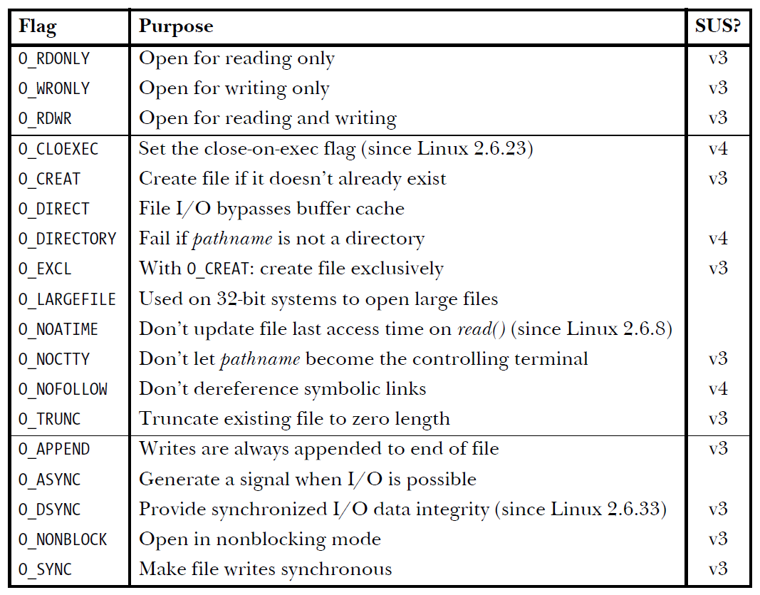
POSIX File I/O (cont.)
Open File (cont.)

Slide 9
POSIX File I/O (cont.)
Read File
#include <unistd.h>
ex. : int ret = read( fd, buffer, 4096);
fd : file descriptor.
buffer : The buffer argument supplies the address of the memory buffer into which the input data is to be placed.
count : The count argument specifies the maximum number of bytes to read.

Slide 10
POSIX File I/O (cont.)
Write File
#include <unistd.h>
ex. : int ret = write( fd, newData, 4096);
fd : file descriptor.
buffer : buffer is the address of the data to be written.
count : count is the number of bytes to write from buffer

Slide 11
POSIX File I/O (cont.)
Changing the File Offset
#include <unistd.h>
ex. : int curr = lseek( fd, 0, SEEK_CUR);
fd : file descriptor.
offset : The offset argument specifies a value in bytes.
whence : The whence argument indicates the base point from which offset is to be interpreted

Slide 12
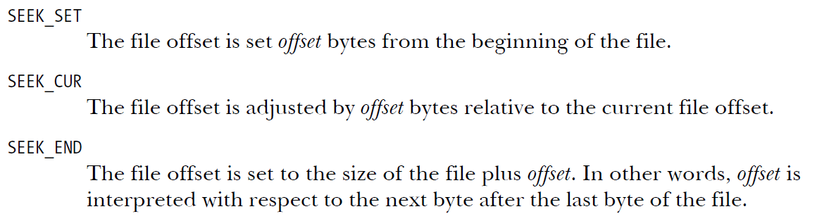
POSIX File I/O (cont.)
Changing the File Offset (cont.)

Slide 13
POSIX File I/O (cont.)
Close File
#include <unistd.h>
ex. : int ret = close( fd );
fd : file descriptor.

Slide 14
Other APIs
Allocate Aligned Memory
#include <stdlib.h>
void *valloc(size_t size)
return a pointer to the allocated memory, or NULL if the request fails
ex. : char *buffer = valloc( sizeof(char) * 4096 );
size : allocates size bytes.
The memory address will be a multiple of the page size.

Slide 15
Other APIs (cont.)
Messure Time
#include <sys/time.h>
int gettimeofday( struct timeval *tv, struct timezone *tz );
struct timeval {
time_t tv_sec; /* seconds */
suseconds_t tv_usec; /* microseconds */
};
struct timezone {
int tz_minuteswest; /* minutes west of Greenwich */
int tz_dsttime; /* type of DST correction */
};

Slide 16
Other APIs (cont.)
Messure Time (cont.)
  int main()
  {
  struct timeval start;
  struct timeval end;
  unsigned long diff;
  gettimeofday(&start,NULL);
  delay(10);
  gettimeofday(&end,NULL);
  diff = 1000000 * (end.tv_sec - start.tv_sec) +
  end.tv_usec - start.tv_usec;
  printf("the difference is %ld (us)\n”, diff);
  return 0;
  }

Slide 17
Other APIs (cont.)
rand()
  rand() function is provided by stdlib.h library.
  Returns a pseudo-random number in the range of 0 to RAND_MAX.
#include<stdlib.h>
int rand(void);
ex. : rand();

Slide 18
Other APIs (cont.)
srand()
  srand() function is provided by stdlib.h library.
  This function seeds the random number generator used by the function rand().
#include<stdlib.h>
void srand(unsigned int seed);
ex. : srand(1000);

Slide 19
Other APIs (cont.)
time()
  time() function is provided by time.h library.
  Calculates the current calender time and encodes it into time_t format.
#include<time.h>
time_t time(time_t *t);
ex. : time(NULL);

Slide 20
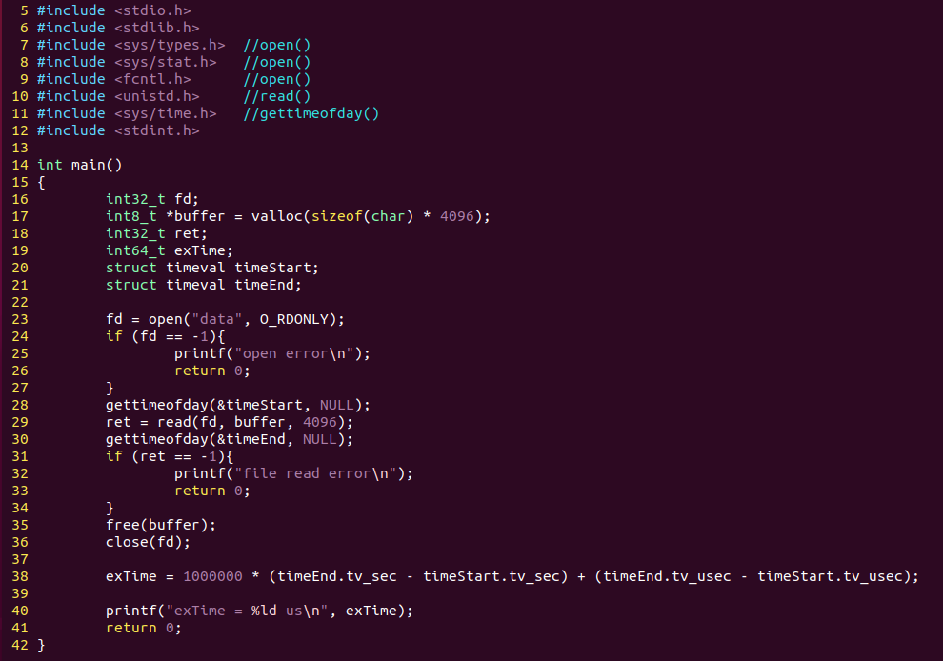
Example

Slide 21
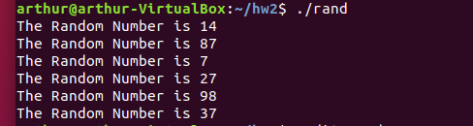
Random number example
#include <stdio.h>
#include <stdlib.h>
#include <time.h>
void main()
{
int a;
srand(time(NULL));
for(int i=0; i<=5; i++){
a=(rand()%100)+1;
printf("The Random Number is %d \n", a);
}
}

Slide 22
Outline
File Input / Output
Application Programming Interface
  POSIX File I/O
  Other APIs
Homework Assignment #1
Reference

Slide 23
Homework Assignments #1: Sequential
1st: Write a program that creates a 100MB file on your local disk
2nd: Measure the time of following three I/O access scenarios
Sequential Read / Write (30%)
  Sequential Read:
    Read the file sequentially by reading the file from beginning to end.
  Sequential Write:
    Overwrite the file with 100MB of new data by writing the file from beginning to end.
  Sequential Write (using O_DIRECT):
    Overwrite the file with 100MB of new data by writing the file using O_DIRECT flag from beginning to end.

Slide 24
Homework Assignments #1: Random
1st: Write a program that creates a 100MB file on your local disk
2nd: Measure the time of following three I/O access scenarios
Random Read / Write(Do 50,000 times) (30%)
  Random Read:
    Choose 4KB-aligned offset in the file uniformly at random, seek to that location in the file, and read 4KB of data at that position.
  Random Write:
    Choose 4KB-aligned offset in the file uniformly at random, seek to that location in the file, and overwrite the file with 4KB of new data at that position.
  Random Write (using O_DIRECT):
    Choose 4KB-aligned offset in the file uniformly at random, seek to that location in the file, and overwrite the file using O_DIRECT flag with 4KB of new data at that position.

Slide 25
Homework Assignments #1
Sequential Read / Write (30%)
  each program 10%
Random Read / Write (30%)
  each program 10%
Word (40%)
  Explain your execution times.
    Compare and explain your results of Sequential Read, Sequential Write and (O_DIRECT) Sequential Write. (8%)
    Compare and explain your results of Random Read, Random Write and (O_DIRECT) Random Write. (8%)
    Compare and explain your results of Sequential Read and Random Read. (8%)
    Compare and explain your results of Sequential Write and Random Write. (8%)
    Compare and explain your results of (O_DIRECT) Sequential Write and (O_DIRECT) Random Write. (8%)

Slide 26
Appendix
Get readahead size
Set readahead to 0
Clear page cache, dentries, inode
  1st: Sync dirty data to disk
  2nd: clear page cache

Slide 27



Appendix
How to use O_DIRECT flag
Include headler
Add #define __USE_GUN 1 over #include <fcntl.h>

Slide 28
Flowchart
Start time
Initial
1st: Create a 100MB file
2nd: Set readahead to 0
3th: Clear page cache
Read or Write
End time
Start
Close file
Open file
Print time difference
End

Slide 29
Result
Sequential Read
Sequential Write
Sequential Write (O_DIRECT)

Slide 30
Result
Random Read
Random Write
Random Write (O_DIRECT)

Slide 31
Turn in
Deadline
2020/04/08 PM.11:59:59
Upload to ilearning
File name
  HW1_ID.zip (e.g. HW1_7105056035.zip)
    Source code
      .c file
    Word
If you don’t hand in your homework on time, your score will be deducted 10 points every day.

Slide 32
Rules
No cheat work is acceptable
  You get zero if you copy other people’s version.
Only single job is accepted

Slide 33
TA
Name：Cheng-Chia, Chang
Email：s9001055@gmail.com
  Title format : FS HW#1 - [your name]
Lab: OSNET(1001A)

Slide 34
Reference
Operating System Concepts, 10th Edition
The Linux Programming Interface:
A Linux and UNIX System Programming Handbook
https://systemprogrammingatntu.github.io/

